Slide 1
SMART TRAVEl PLANNER PROJECT REPORT | Course Code: CSI3001 Slot: B1+TB1 Name of the Faculty: Devipriya AMAL MK 24MID0176 ALEX SHAJI 24MID0179 DEVADHARSH S 24MID0210 GOKUL TN 24MID0205 CLOUD COMPUTING METHODOLOGIES

Slide 2

Smart Travel Planner
The Smart Travel Planner is an innovative web application designed to transform the travel planning experience by offering a seamless, personalized, and efficient solution. In today's complex travel landscape, where numerous options and variables can overwhelm travelers, the Smart Travel Planner integrates multiple modules—including real-time weather data, budget management, and AI-driven itinerary generation—to simplify intricate tasks and provide tailored recommendations.
This application aspires to deliver a comprehensive solution that guides users from the initial destination selection to the creation of a detailed, customized itinerary and effective budget management. It utilizes advanced APIs, particularly large language models, to craft a personalized travel plan that considers user preferences, real-time conditions, and financial constraints.

Slide 3
Objective
The primary objective of the Smart Travel Planner is to develop a comprehensive, personalized, and efficient platform that streamlines the entire trip planning process for users.
The key goals of the project include:
Facilitating Personalized Trip Planning
Providing Real-Time Insights
Generating AI-Powered Itineraries
Integrate external APIs to deliver real-time weather forecasts and currency conversion rates, ensuring the itinerary and budget are based on current, relevant data.
Empower users to define their preferred budget, travel dates, interests, and destination to create a unique travel profile.
Employ advanced AI to create a detailed, day-wise travel plan that adapts to constraints such as weather and user preferences, like prioritizing sightseeing in the morning and local activities in the afternoon.
Offering Comprehensive Budget Management
Ensure a Seamless User Experience
Estimate the total trip cost (flights, hotels, food, activities), compare it against the user's budget, and suggest more cost-effective alternatives if necessary.
Provide a mobile-friendly, responsive interface with intuitive data visualization, including maps and budget breakdowns, to enhance the user experience.

Slide 4
Modules
The Smart Travel Planner is structured around several interconnected modules that work together to provide a cohesive and intelligent planning experience.
User Module
1
Purpose: Manages user identity, security, and personalization.
Functionality: Handles user registration and login. Allows users to manage their profile, including saving their preferred budget, interests, and past trips for future planning.
Destination & Input Module
2
Purpose: Captures and validates the core trip parameters from the user.
Functionality: Collects essential inputs like destination, travel dates, budget, and preferences. It also validates these inputs (e.g., ensuring the budget is a number and the date is valid) and passes the data to the other core modules.
Core Planning Modules
3
Weather Module: Fetches real-time weather and forecast data, displays information (temperature, conditions), and suggests the best days or activities based on the forecast to prevent scheduling outdoor trips on rainy days.
Budget Module: Estimates all trip costs (flights, hotels, food, activities), compares the estimate against the user's input budget, displays a budget summary (like a pie chart), and suggests lower-cost alternatives if the estimated cost exceeds the budget.
Advanced Functionality Modules
4
AI Suggestion Module: Develops a comprehensive, day-wise itinerary, offering a structured daily plan such as Morning → sightseeing, Afternoon → dining/local activities, and Evening → events/shopping. This module dynamically adjusts the itinerary based on weather conditions, while allowing users to personalize the suggested plan to better suit their preferences.
User Interface & Data Management Modules
5
Visualization & UI Module: Presents all trip data via a dashboard. It includes weather cards, a budget breakdown using libraries like Chart.js or Recharts, and map integration (Google Maps/Leaflet). It is designed to be mobile-friendly and responsive.
Database/Storage Module: Saves the user's trip plans and preferences. It also stores frequently searched destinations to improve loading times. For a small project scope, local storage or a JSON file can be used.

Slide 5
API Integration
The Smart Travel Planner relies on integration with powerful external APIs to deliver its core features, similar to how the MOCK AI uses the Google Gemini API for its main functions.
API Name
Purpose
Integration Details
Gemini AI (2.5 Flash)
AI Suggestion & Itinerary Generation
Used to generate the detailed, day-wise itinerary based on user input and constraints from other modules (like weather).
The Google Geocoding API
Geocoding
Converts addresses or place names (text input) into geographic coordinates (latitude and longitude)
Google Maps Javascript API
Mapping and Location Services
Provides open and reusable map data for integrating location details and map visualization on the UI dashboard. Used inside the same Maps API script
Google Places API
Mapping and Location Services
Finds nearby attractions to mark on map

Slide 6


Methodology: Module Interaction Flow
The system operates in a sequential flow, ensuring that all data is processed logically to produce a final, personalized trip plan.
User Input
The user first logs in via the User Module and then provides the essential trip details (Destination, Date, Budget, Preferences) through the Destination & Input Module.
Data Processing
The system fetches real-time weather from the Weather Module. It calculates the estimated trip cost and compares it to the user's budget via the Budget Module.
Itinerary Generation
The collected data (user preferences, weather, budget insights) is passed to the AI Suggestion Module, which uses the Gemini API to generate a customized, day-wise itinerary that is automatically adjusted based on conditions like weather.
Presentation
All final information—the itinerary, weather summary, budget breakdown, and a map of the destination—is displayed on the main dashboard through the Visualization & UI Module.
Storage
The final trip plan and user preferences are saved in the Database/Storage Module for future access and reference.

Slide 7
Conclusion
The Smart Travel Planner is a convenient tool designed to make trip planning simpler and more tailored to individual needs. It integrates key features like user preferences and budget management with advanced tools such as a weather module and AI-generated itineraries. This combination helps streamline the often complex process of organizing a trip. By leveraging various APIs, the planner becomes even more effective: GeminiAI assists in creating personalized travel plans, provides current weather updates, and GoogleMap offers precise mapping services. Together, these features ensure users enjoy a seamless experience, with travel plans that align with their personal preferences and budget. This makes the Smart Travel Planner an excellent choice for anyone seeking to plan their travels more efficiently and enjoyably.

Slide 8
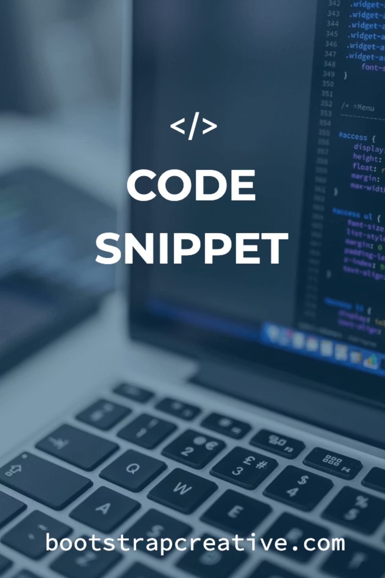
Sample Code
Implementation examples demonstrating the Smart Travel Planner's core functionality:

Slide 9
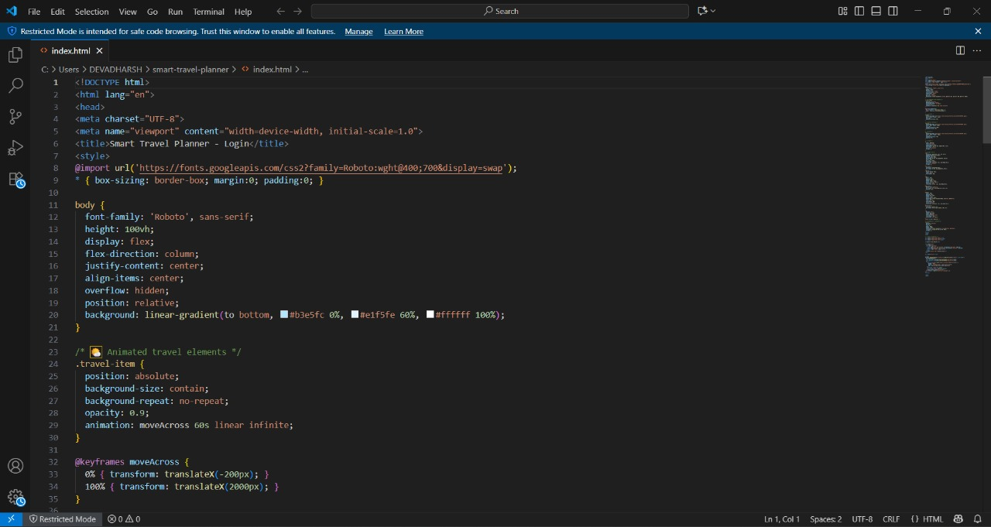
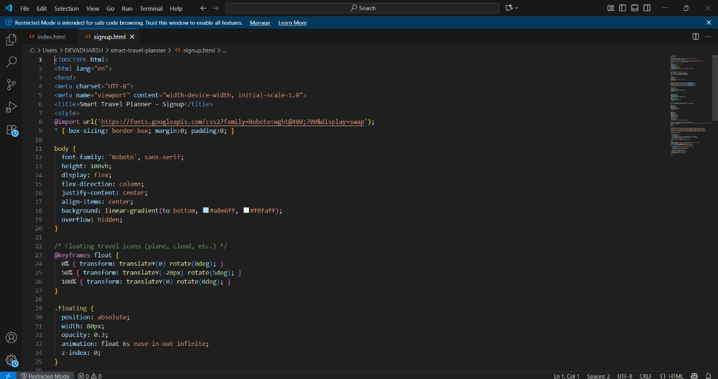
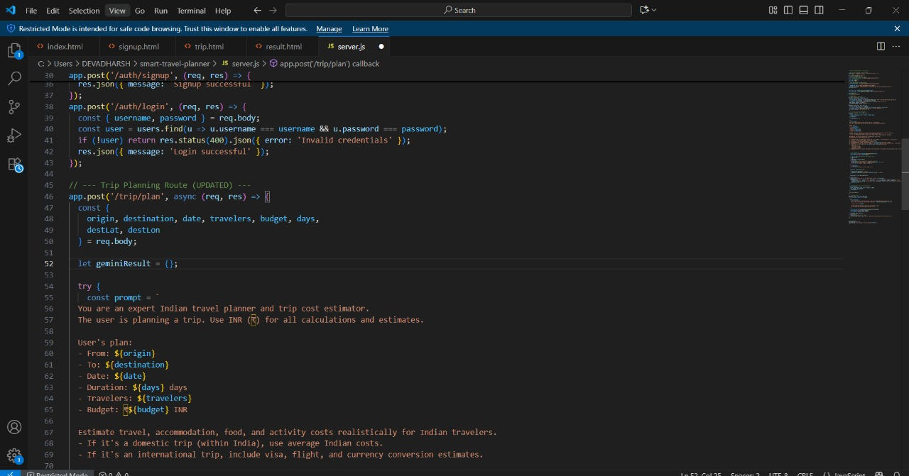
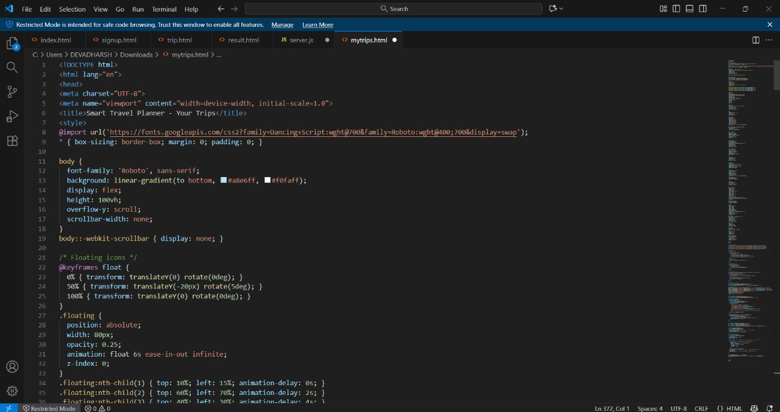

Slide 10
Sample Output
Visual demonstrations of the Smart Travel Planner's user interface and dashboard displays:

Slide 11
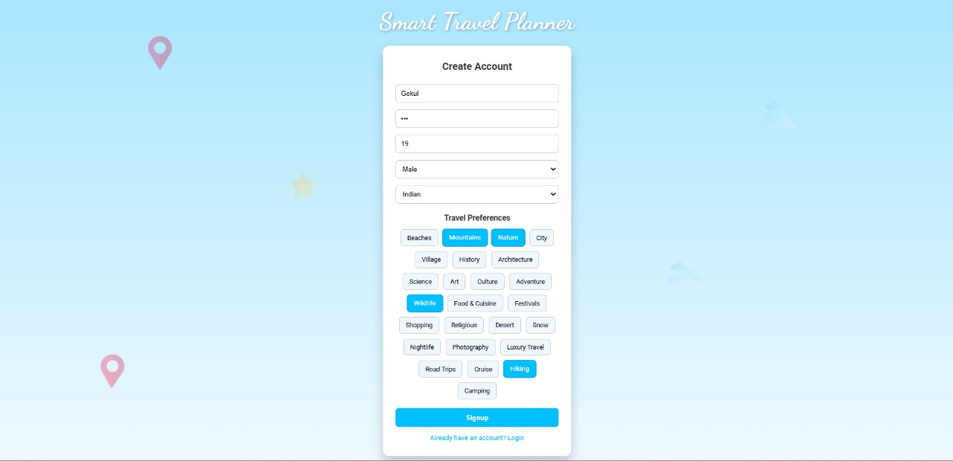
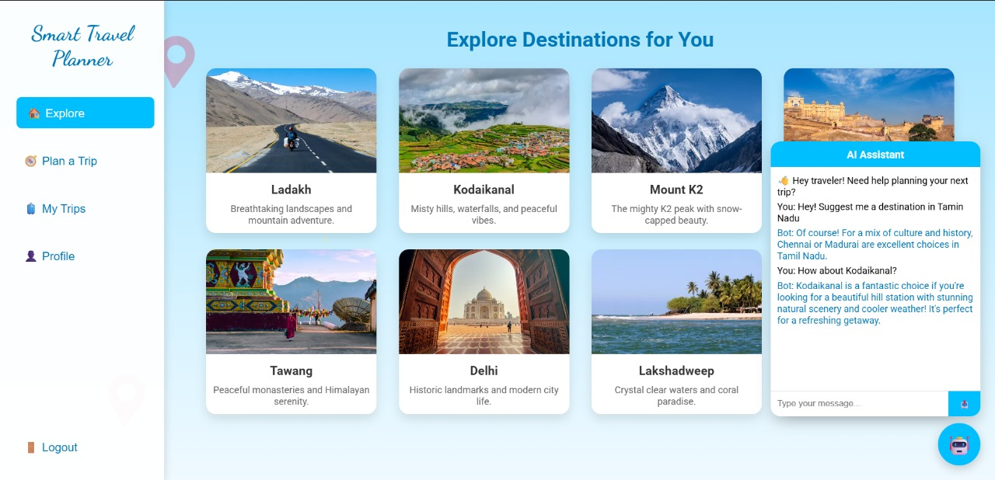
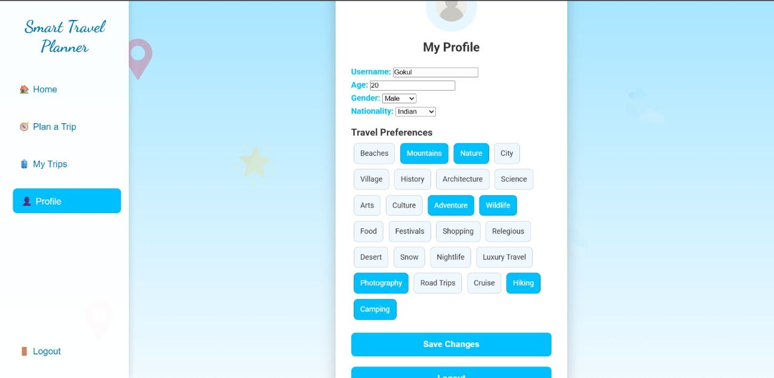
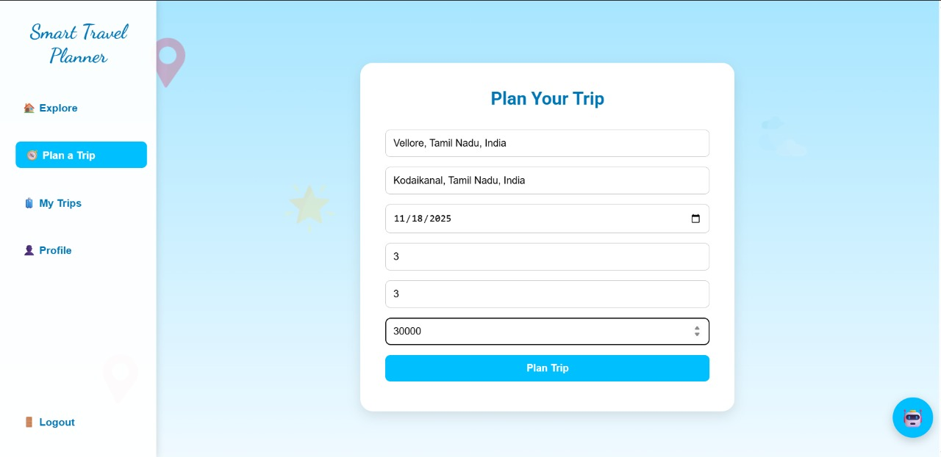

Slide 12
